Slide 1
SS8H2bc
Georgia’s
History
The Colonial Period
© 2014 Brain Wrinkles

Slide 2
Standards
SS8H2 The student will analyze the colonial period of Georgia’s history.
b. Evaluate the Trustee Period of Georgia’s colonial history, emphasizing the role of the Salzburgers, Highland Scots, malcontents, and the Spanish threat from Florida.
c. Explain the development of Georgia as a royal colony with regard to land ownership, slavery, government, and the impact of the royal governors.
© 2014 Brain Wrinkles

Slide 3
SS8H2c
Georgia:
A Royal
Colony
© 2014 Brain Wrinkles

Slide 4
COMPARING TWO COLONIES
GEORGIA
SOUTH CAROLINA
TRUSTEE COLONY
NO SLAVERY
NO RUM
LAND LIMITS 500 acres
FEMALE COULD NOT INHERIT LAND
FORCED TO GROW MULBERRY TREES, GRAPES, AND INDIGO PLANTS
STRUGGLED TO MAKE MONEY
ROYAL COLONY
SLAVERY WAS ALLOWED
TRADE RUM WITH INDIANS
NO LAND LIMITS
FEMALES COULD INHERIT LAND
COULD GROW COTTON, RICE, AND TOBACCO
VERY PROFITABLE

Slide 5
Royal Colony
In 1752, the Trustees surrendered control of the colony to the King and Georgia became a royal colony.
Restrictions on land ownership and slavery were removed and Georgia began to thrive economically.
© 2014 Brain Wrinkles

Slide 6
Slave Labor
Georgia’s slave population grew from less than 500 in 1750 to 18,000 in 1775.
Colonists began to build plantations in the river deltas where slaves cultivated rice in the fertile marshlands.
They also grew other successful crops, such as, indigo, corn, peas, wheat, rye, and tobacco.
Georgia’s thriving economy relied heavily on slave labor.
© 2014 Brain Wrinkles

Slide 7
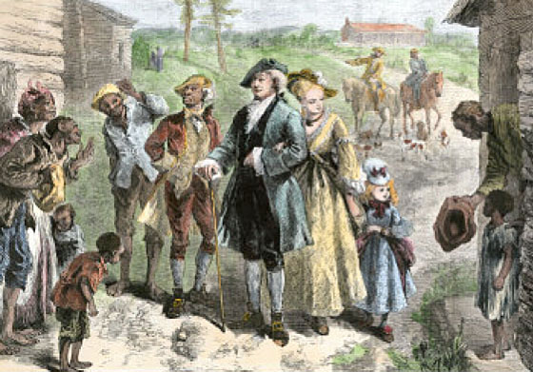
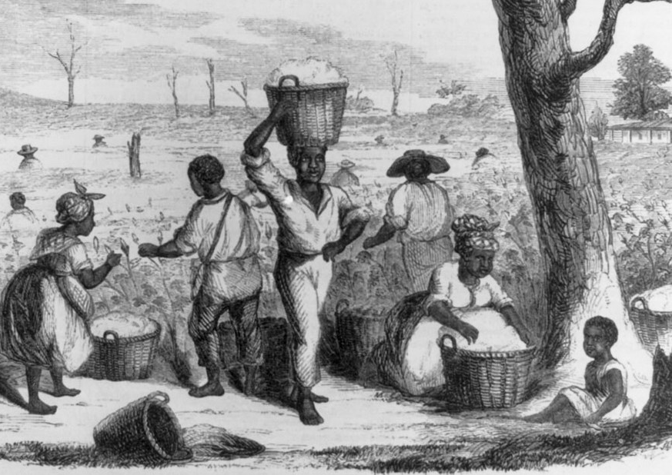
Slavery in
Colonial Georgia
© 2014 Brain Wrinkles

Slide 8
New Government
The new royal government needed new government officials, including an attorney general, head of military, and a royal governor.
There was also a legislature that was made up of a council, court of appeals, and two representatives from each county in the colony.
© 2014 Brain Wrinkles

Slide 9
John Reynolds
Georgia’s first governor was John Reynolds, who served from 1754 to 1756.
He was a former naval officer.
Reynolds had many conflicts with the colonial legislature, so the king revoked his position.
** Set up court systems.
**Very poor relationship with the Natives.
© 2014 Brain Wrinkles

Slide 10
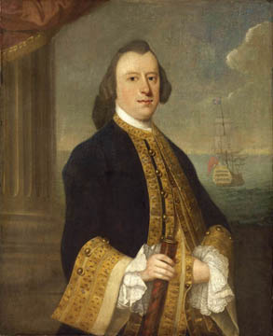
John Reynolds
© 2014 Brain Wrinkles

Slide 11
Henry Ellis
Explorer Henry Ellis served as the next governor from 1757 to 1760.
He worked well with the legislature and the Native Americans.
Ellis showed the colonists how to govern themselves, explaining the need for a budget, taxes, and military defense.
He left office in 1760 due to poor health.
**Well liked and respected.
© 2014 Brain Wrinkles

Slide 12
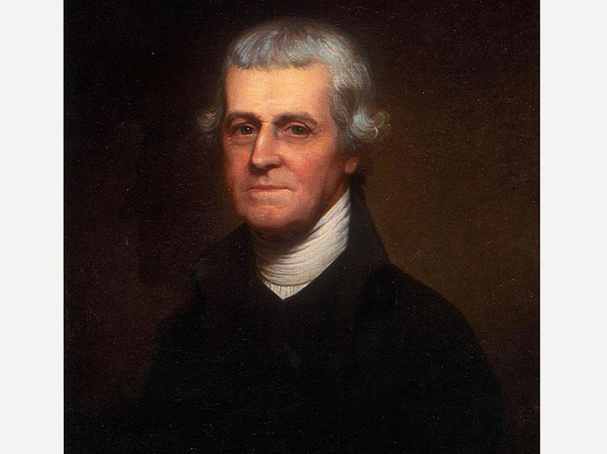
Henry Ellis
© 2014 Brain Wrinkles

Slide 13
James Wright
Georgia’s final royal governor, James Wright, served from 1760 to 1776.
He was a popular governor who negotiated important treaties with the Native Americans that opened up millions of acres for settlement.
Georgia prospered and grew faster than any other English colony under Wright’s leadership.
Wright stayed loyal to England when the Revolutionary War began and was eventually arrested.
© 2014 Brain Wrinkles

Slide 14
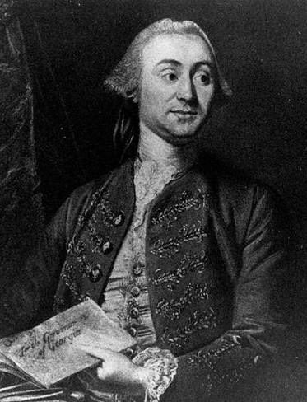
James Wright
© 2014 Brain Wrinkles

